Slide 1

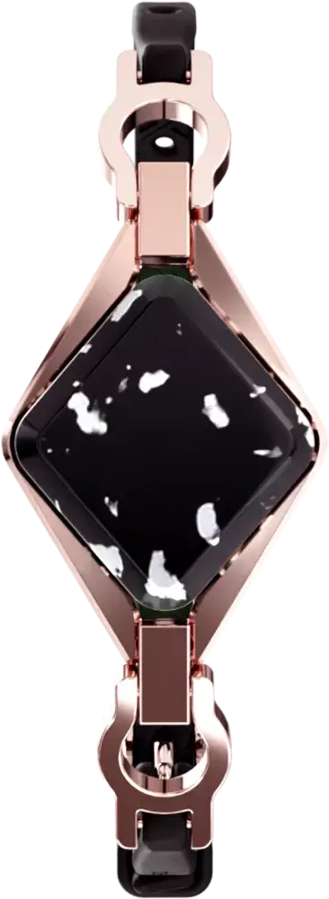









MARKETING STRATEGY PROPOSAL
Presented by:
Roxanna Rodriguez
Marketing Analytics Team
July 2022

Slide 2
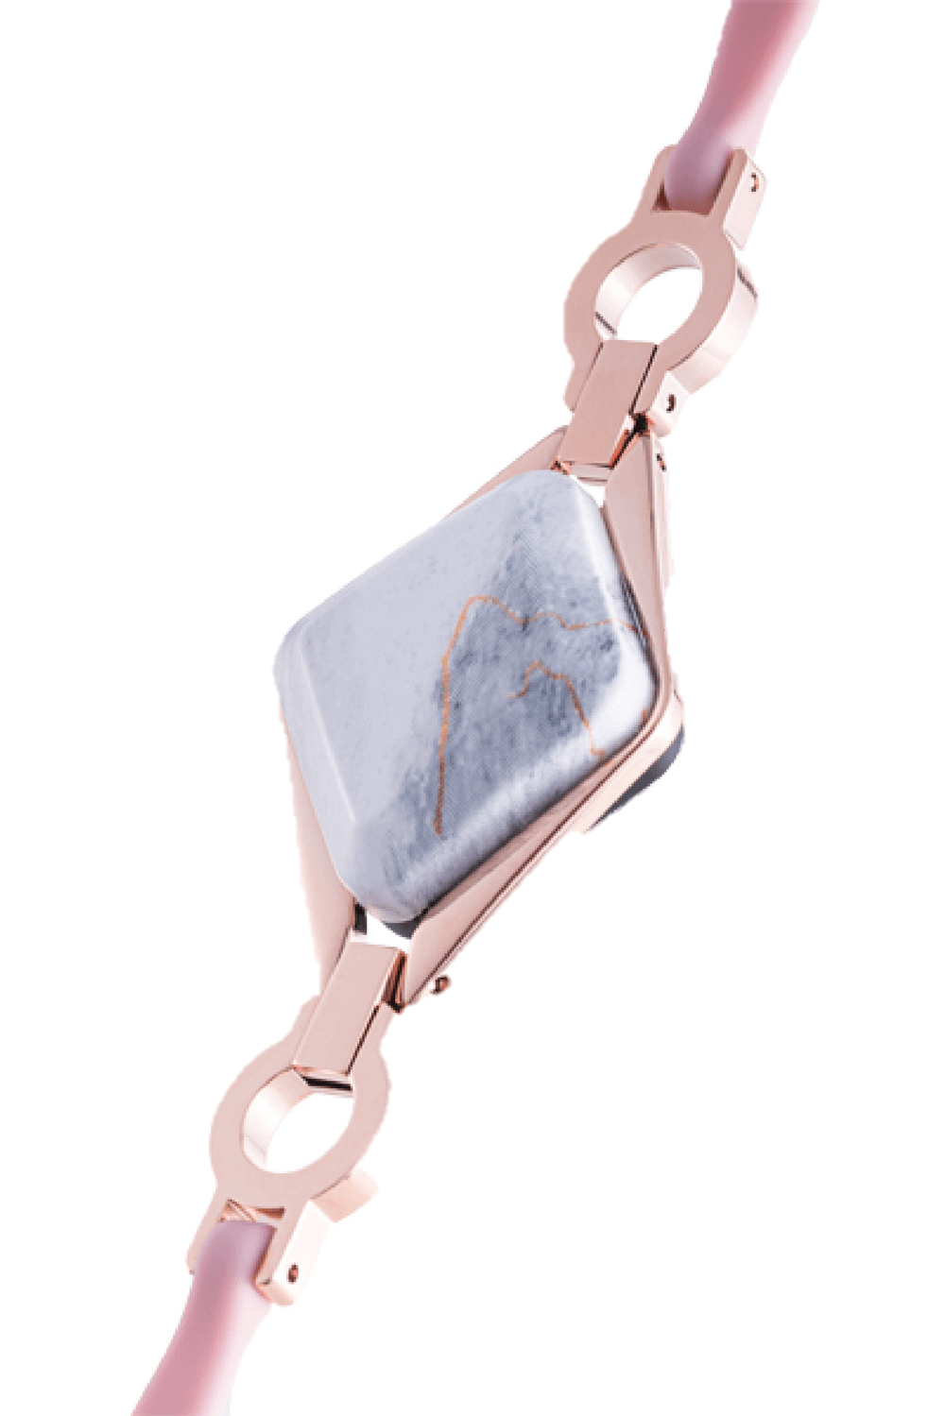
What is the situation?
MARKETING STRATEGY PROPOSAL
CONTENT
Current situation
Business Task
Analysis and Findings
Recommendations

Slide 3

Business Task
What is the situation?
1.
Bellabeat is considered to have the potential to become a major player in the global smart device market.
2.
We want to understand the behavior of non-Bellabeat consumers to inform marketing strategies.
3.
The current marketing strategy focuses on digital marketing, but traditional media is also used in a smaller scale.

Slide 4

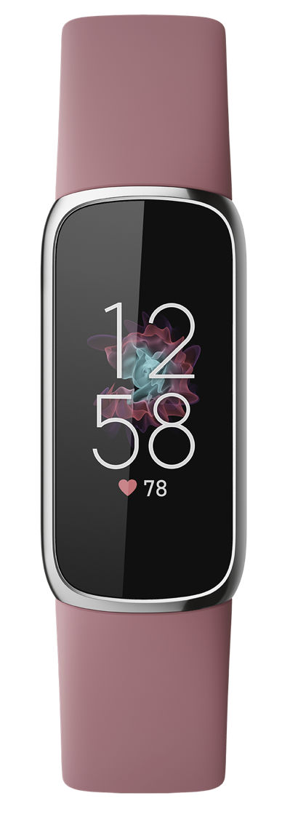
What is the situation?
Analysis and Findings
Business Task
Understand how consumers are using their smart devices based on usage data to discover opportunities for growth and inform and guide marketing strategies.

Slide 5

Business Task
Analysis and Findings
Data Sources
FitBit Fitness Tracker Data – Public Dataset
33 distinct participants (Fitbit users)
From April 11, 2016 to May 12, 2016
Daily and hourly data
Steps, distance, intensities, calories burned and sleep
*For more info on the cleaning process and manipulation of data, please refer to the report.

Slide 6
Analysis and Findings
Active Users
- 100 %
Initially, 100% of the participants used the device.
- 64 %
This percentage gradually decreased.
By the end of the month, only 64% of the participants were using their devices.

Slide 7
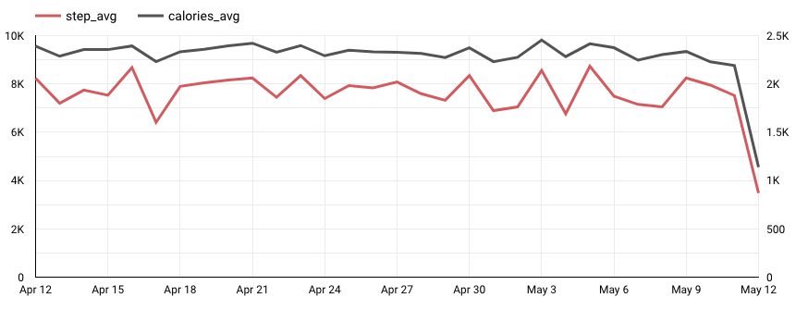
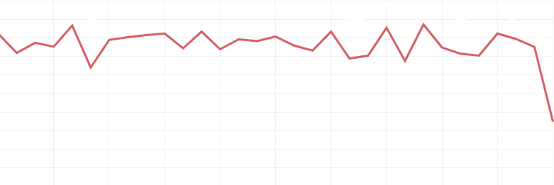
Analysis and Findings
Steps and Calories
steps
calories
The average number of steps remains relatively consistent throughout the month.
The same is true for the number of calories burned.

Slide 8
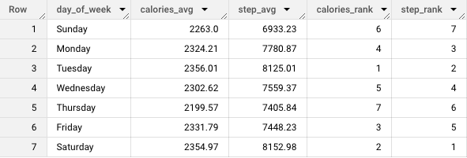
Analysis and Findings
Steps and Calories
Less steps and calories
More steps and calories
The number of steps and calories burned behave similarly when looking at the averages by day of the week.

Slide 9
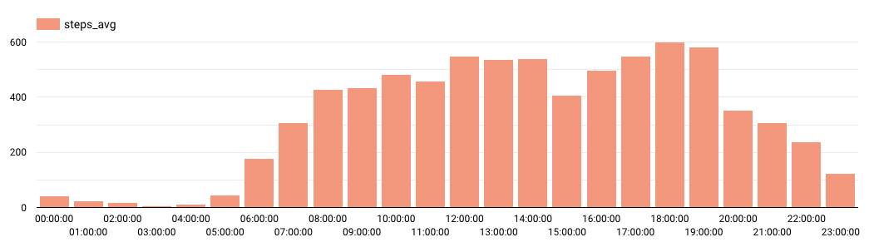
Analysis and Findings
Steps and Calories
A similar patterns is seen in the number of calories burned.
Users take the highest number of steps between 12:00 - 15:00 and 17:00 - 20:00. This might indicate more steps during lunch breaks and after work hours.

Slide 10
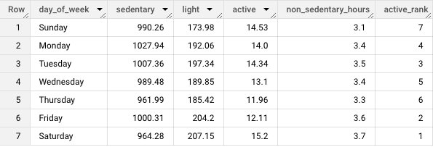
Analysis and Findings
Intensities
The average of very active minutes for every day of the week is only between 12 and 15.
The intensities through the week correspond to the steps and calories burned, being Saturday and Tuesday among the most active and Sunday and Thursday among the least active.

Slide 11
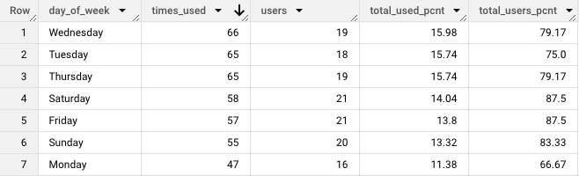
Analysis and Findings
Sleep
Only 24 out of the 33 participants used the sleep function, of which only 12.5% (3 out of 24) used it every day.
There seems to be no relationship between the days with higher activity and the use of the sleep function.

Slide 12
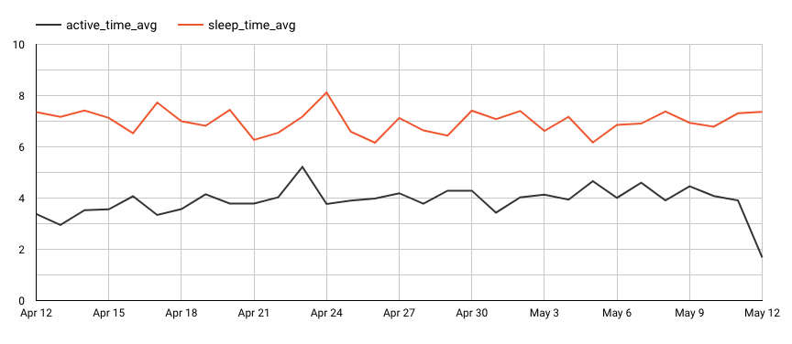




Analysis and Findings
Sleep
The average sleep time for all the users throughout this month was
7 hours.
There seems to be a relationship between the active time* and the number of hours slept.
*Active time is the sum of lightly active minutes and very active minutes.

Slide 13

The average sleep time from all the users through this month was 7 hours.
There seem to be a relationship between the active time* and the number of hours slept.
Analysis and Findings
No demographics

Slide 14



Analysis and Findings
Users are working between 8:00 – 17:00

Slide 15


Analysis and Findings
Users are moderately active

Slide 16


Analysis and Findings
Peaks of activity are during lunch breaks and after work

Slide 17

Analysis and Findings
Most active days are Saturday and Tuesday
Least active days are Sunday and Thursday

Slide 18

Analysis and Findings
Steps, calories burned, and intensities are correlated

Slide 19

Analysis and Findings
Users have more steps and burn more calories than average

Slide 20

Recommendations
Analysis and Findings
Activity time and sleep time are correlated

Slide 21
Analysis and Findings
Recommendations
Create two distinct marketing campaigns:
1
2
Individuals with sedentary lifestyles
Individuals with active lifestyles
Highlighting the advantages of wearing this kind of devices.
Highlighting the features that are not currently used.
Based on the assumption that people wearing these devices tend to have a healthier and more active life.
Based on the assumption that the users are unaware of these features and their potential benefits.

Slide 22



Recommendations
Select social media channels
1
2
Until having more demographic data – continue using digital marketing as main channel and traditional ads as secondary channel.
Individuals with sedentary lifestyles
Individuals with active lifestyles
Create in-app notifications for current users, encouragin the use of different features – motivational messages, trends, progress.
Highlighting the advantages of wearing this kind of devices.
Highlighting the features that are not currently used.
Define social media goals and KPIs
Based on the assumption that people wearing these devices tend to have a healthier and more active life.
Based on the assumption that the users are unaware of these features and their potential benefits.
Define Key Performance Indicators based on the increase of number of users, user retention rates and usage of the different features.

Slide 23

Recommendations
Define customer profiles
e.g. Target women interested in this type of devices but that might not use them in specific occasions because of the lack of “fashionable” element.
This might include both women that would use Bellabeat as their main wearable device and women that would like to have an alternative device for specific occasions.
* This can be better informed after extending the analysis with a larger sample.
Until having more demographic data – continue using digital marketing as main channel and traditional ads as secondary channel.
Define Key Performance Indicators based on the increase of number of users, user retention rates and usage of the different features.
Define social media goals and KPIs
Select social media channels
Create in-app notifications for current users, encouraginf the use of different features – motivational message, trends, progress.

Slide 24
Make informed decisions about your health.
Every day.
Next Steps
Expand analysis
Using a larger sample size and extending the timeframe to have more acurate and relevant results.
Compare with internal data
To assess Bellabeat customers’ behavior within the larger market, and understand portential market niches.
Based on further analysis
Assess the relevance of targeting people that want to improve sleeping habits, showing if there is a correlation between levels of activity and hours of sleep.
The only health tracker designed and engineered for women.

Slide 25
Recommendations
Make informed decisions about your health.
Every day.
The only health tracker designed and engineered for women.
Bellabeat.com

